Slide 1
Covid19 study
Ahmed Tarek hosny 16p8118
Ahmed montasser hussien 16p6037

Slide 2
Ingestion & Storage
- Loading the data ("Covid 19 August.csv") into the virtual machine using WinSCP
- Loading the file to the HDFS by using shell script ("loadtohdfs.sh")

Slide 3
Analysis
- Creating 3 tables in Hive using an hql script("hivescript.hql"):
• Staging table for pointing to dataset location
• ORC table partitioned by Country
• Final table to generate the final report

Slide 4
Workflow
- Creating an oozie workflow that executes the scripts for the HDFS and the Hive, then exporting the final result as ("COVID_FINAL_OUTPUT")

Slide 5
Visualization
- Taking the output from the Oozie workflow ("COVID_FINAL_OUTPUT") to Power BI
- Demonstrating the top 10 countries by tests on map and pie chart
- Demonstrating the top 10 countries by new deaths on map

Slide 6
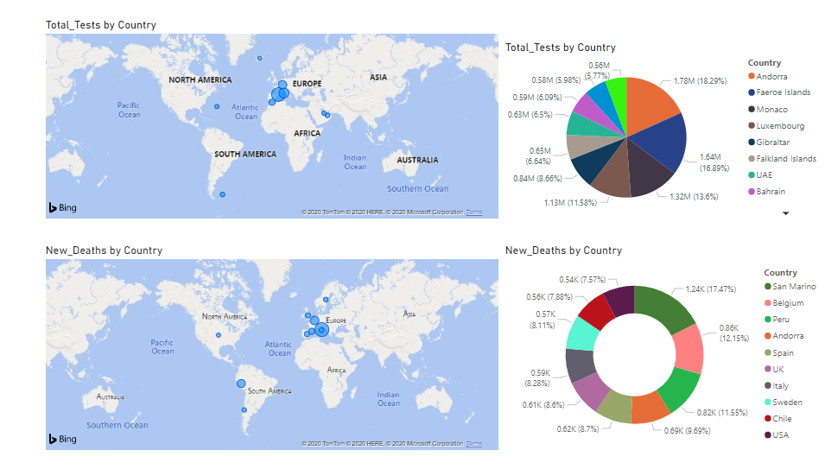
Visualization

